Slide 1
Week 4
Top down Parser Left Recursion and Left Factoring

Slide 2
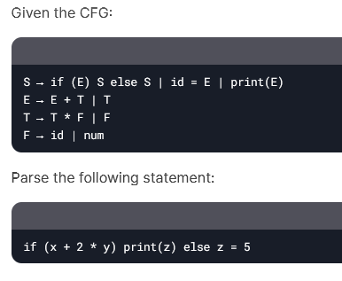
Quiz 3
Write a CFG for simple assignment statements where:
An assignment is of the form id = E. E can be an expression involving addition (+) and multiplication (*).
2) Make the parse tree based on operator precedence of the following expression 3 + 5 * 2 < 10 - 4 / 2 && 1 == 1
3) Make the parse tree.

Slide 3
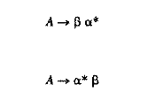
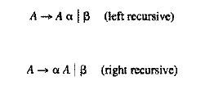
EBNF Form

Slide 4
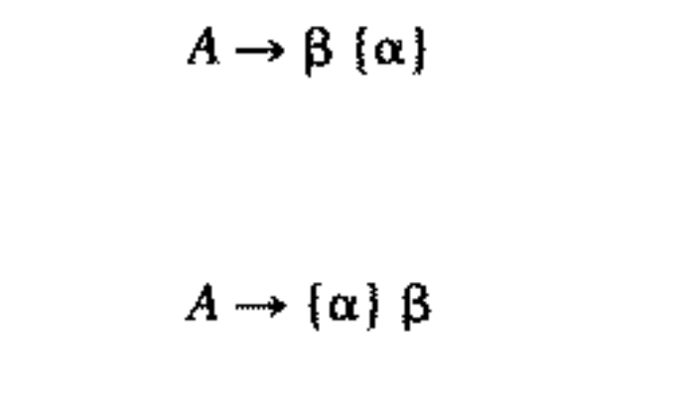
EBNF

Slide 5
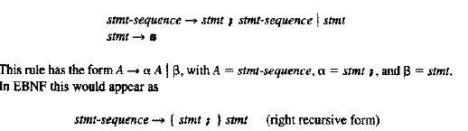
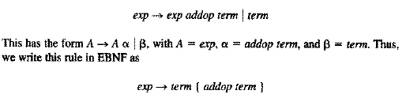
Examples

Slide 6
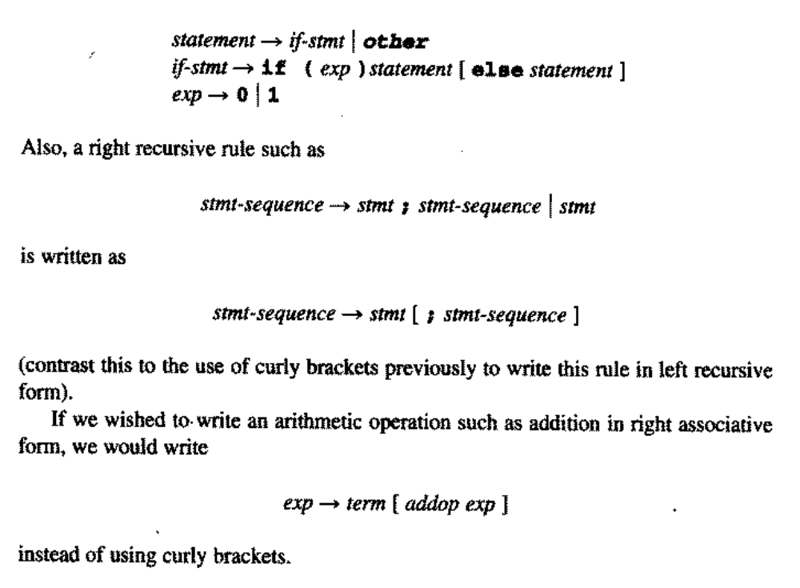

Slide 7
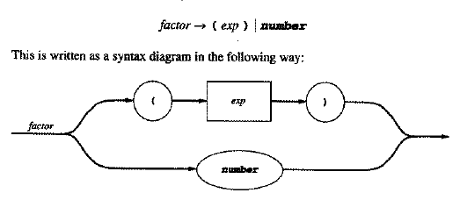
Syntax Diagrams

Slide 8
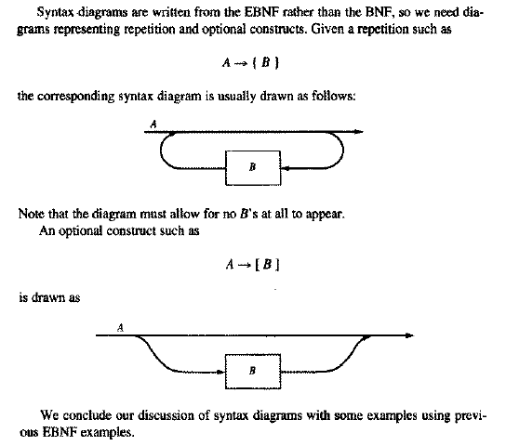

Slide 9
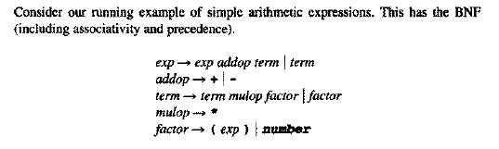
Example

Slide 10
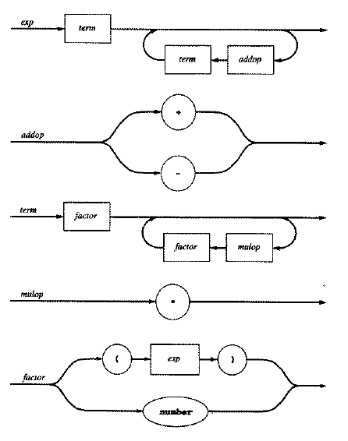
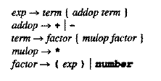

Slide 11
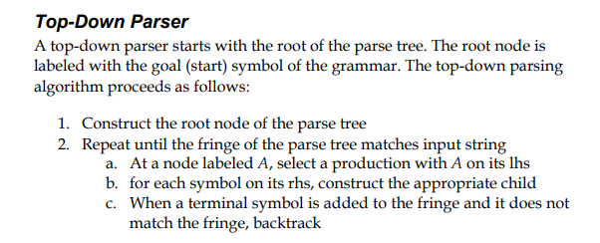
Parser

Slide 12
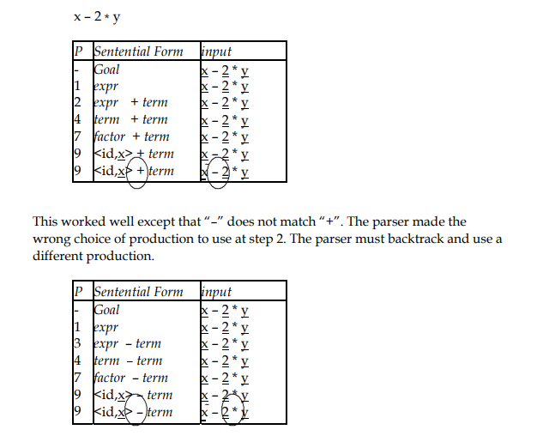

Slide 13
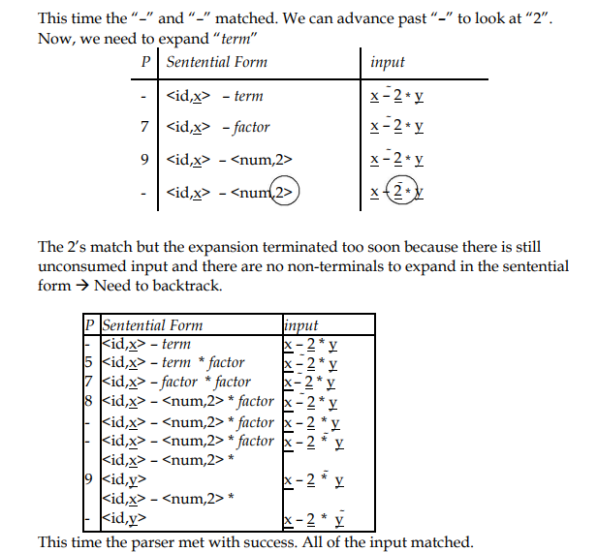

Slide 14
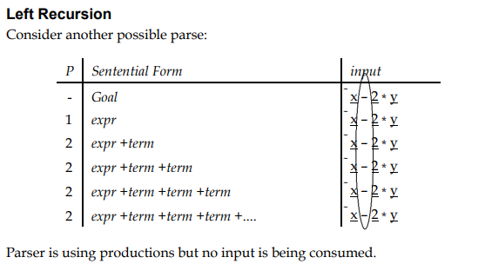

Slide 15
Recursive-Descent Parsers
An advantage of top-down parsing is that it is easy to implement by hand
Key idea: write a function (procedure, method) corresponding to each non-terminal in the grammar
  Each of these functions is responsible for matching its non-terminal with the next part of the input
F-<number>

Slide 16
Example: Statements
Grammar
stmt ::= id = exp ;
| return exp ;
| if ( exp ) stmt
| while ( exp ) stmt
Method for this grammar rule
// parse stmt ::= id=exp; | …
void stmt( ) {
switch(nextToken) {
RETURN: returnStmt(); break;
IF: ifStmt(); break;
WHILE: whileStmt(); break;
ID: assignStmt(); break;
}
}
F-<number>

Slide 17
Example (cont)
// parse while (exp) stmt
void whileStmt() {
// skip “while (”
getNextToken();
getNextToken();
// parse condition
exp();
// skip “)”
getNextToken();
// parse stmt
stmt();
}
// parse return exp ;
void returnStmt() {
// skip “return”
getNextToken();
// parse expression
exp();
// skip “;”
getNextToken();
}
© 2002-08 Hal Perkins & UW CSE
F-<number>

Slide 18
Another Problem with Recursive Descent Parsers
Suppose the grammar were
S → S S | a
How could the parser decide how many times to use the production S → S S before using the production S → a?

Slide 19
Left Recursion
The method of recursive descent does not work if the grammar is left recursive.
In particular, a production is left recursive if it is of the form
A → Aα.

Slide 20
Left Recursion
Applying the method of recursive descent would lead to the function
void A()
{
A();
// Process α
}
which leads to infinite recursion.

Slide 21
Eliminating Left Recursion
Left recursion in a production may be removed by transforming the grammar in the following way.
Replace
A → Aα | β
with
A → βA'
A' → αA' | ε.

Slide 22
Eliminating Left Recursion
Under the original productions, a derivation of βααα is
A → Aα → Aαα → Aααα → βααα.
Under the new productions, a derivation of βααα is
A → βA' → βαA' → βααA'
→ βαααA' → βααα.

Slide 23
Example: Eliminating Left Recursion
Consider the left recursive grammar
E → E + T | T
T → T * F | F
F → (E) | id
Apply the transformation to E:
E → T E'
E' → + T E' | ε.

Slide 24
Example: Eliminating Left Recursion
Then apply the transformation to T:
T → F T'
T' → * F T' | ε.

Slide 25
Example: Eliminating Left Recursion
Now the grammar is
E → T E'
E' → + T E' | ε.
T → F T'
T' → * F T' | ε.
F → (E) | id

Slide 26
Advantages of Left Recursion
A left recursive grammar is often more intuitive than the transformed grammar.
Bottom-up parsing takes advantage of the benefits of left recursion.

Slide 27
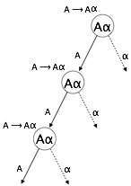
Left-Recursion
A → Aα / β
Left recursion is considered to be a problematic
situation for Top down parsers.
Therefore, left recursion has to be eliminated from
the grammar.
Left-Recursion Elimination
we can eliminate left recursion by replacing the pair
of productions with-
A → βA’
A’ → αA’ / ∈

Slide 28
Left-Recursion
Problem-1: Consider the following grammar and eliminate left recursion-
A → AAα / β
Solution:
The grammar after eliminating left recursion is-
A → βA’
A’ → AαA’ / ∈
Problem-2: Consider the following grammar and eliminate left recursion-
S → S0S1S / 01
Solution:
The grammar after eliminating left recursion is-
S → 01A
A → 0S1SA / ∈

Slide 29
Left-Recursion
Problem-3: Consider the following grammar and eliminate left recursion-
A → ABd / Aa / a
B → Be / b
Solution:
The grammar after eliminating left recursion is-
A → aA’
A’ → BdA’ / aA’ / ∈
B → bB’
B’ → eB’ / ∈
Problem-4: Consider the following grammar and eliminate left recursion-
E → E + E / E x E / a
Solution:
The grammar after eliminating left recursion is-
E → aA
A → +EA / xEA / ∈

Slide 30
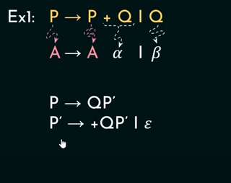
Examples

Slide 31

Indirect left Recursion
Problem 1

Slide 32
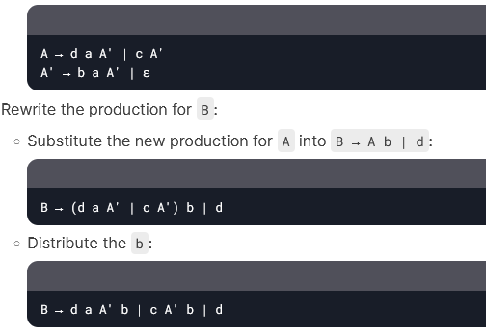

Solution

Slide 33
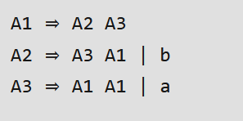
Indirect Left Recursion
https://www.geeksforgeeks.org/removing-direct-and-indirect-left-recursion-in-a-grammar/

Slide 34
Left Recursion Solution
Rewrite using right recursion and a new non-terminal
Original: expr ::= expr + term | term
New
  expr ::= term exprtail
  exprtail ::= + term exprtail | ε
Properties
  No infinite recursion if coded up directly
  Maintains left associatively (required)
© 2002-08 Hal Perkins & UW CSE
F-<number>

Slide 35
Another Way to Look at This
Observe that
  expr ::= expr + term | term
generates the sequence
  term + term + term + … + term
We can sugar the original rule to show this
  expr ::= term { + term }*
This leads directly to parser code
F-<number>

Slide 36
Code for Expressions (1)
// parse
// expr ::= term { + term }*
void expr() {
term();
while (next symbol is PLUS) {
getNextToken(); term()
}
}
// parse
// term ::= factor { * factor }*
void term() {
factor();
while (next symbol is TIMES) {
getNextToken(); factor()
}
}
F-<number>

Slide 37
Code for Expressions (2)
// parse
// factor ::= int | id | ( expr )
void factor() {
switch(nextToken) {
case INT:
process int constant;
getNextToken();
break;
…
case ID:
process identifier;
getNextToken();
break;
case LPAREN:
getNextToken();
expr();
getNextToken();
}
}
F-<number>

Slide 38
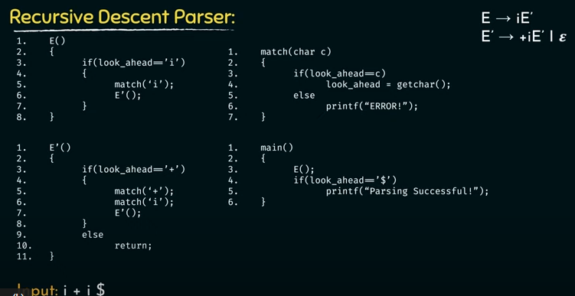

Slide 39
Left-Factoring
Left factoring is a process by which the grammar with common prefixes is transformed to make it useful for Top down parsers.
Example
A → αβ1 / αβ2 / αβ3
Creates a problematic situation for Top down parsers.
Top down parsers can not decide which production must be chosen to parse the string in hand.
Solution : left factoring.

Slide 40
Left Factoring
If two rules for a non-terminal have right hand sides that begin with the same symbol, we can’t predict which one to use
Solution: Factor the common prefix into a separate production
© 2002-08 Hal Perkins & UW CSE
F-<number>

Slide 41
Left Factoring Example
Original grammar
  ifStmt ::= if ( expr ) stmt
  | if ( expr ) stmt else stmt
Factored grammar
  ifStmt ::= if ( expr ) stmt ifTail
  ifTail ::= else stmt | ε
F-<number>

Slide 42
Parsing if Statements
But it’s easiest to just code up the “else matches closest if” rule directly
// parse
// if (expr) stmt [ else stmt ]
void ifStmt() {
getNextToken();
getNextToken();
expr();
getNextToken();
stmt();
if (next symbol is ELSE) {
getNextToken();
stmt();
}
}
F-<number>

Slide 43
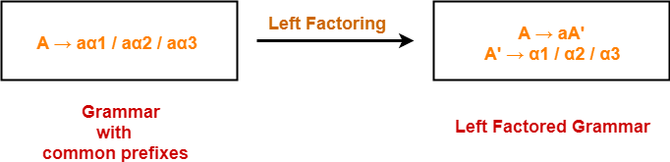
Left-Factoring

Slide 44
Left-Factoring
Problem-1: Do left factoring in the following grammar-
A → aAB / aBc / aAc
A → aA’
A’ → AB / Bc / Ac
A → aA’
A’ → AD / Bc
D → B / c
This is a left factored grammar.

Slide 45
Left-Factoring
Problem-2: Do left factoring in the following grammar-
S → aSSbS / aSaSb / abb / b
S → aS’ / b
S’ → SSbS / SaSb / bb
S → aS’ / b
S’ → SA / bb
A → SbS / aSb
This is a left factored grammar.

Slide 46
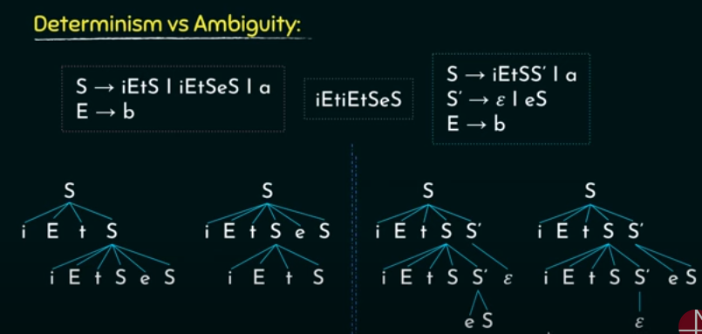

Slide 47
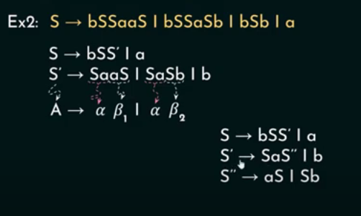


Slide 48
